Slide 1
TRENDS
IN
WEB DESIGN
Maarja-Liis Kaldvee KD22

Slide 2
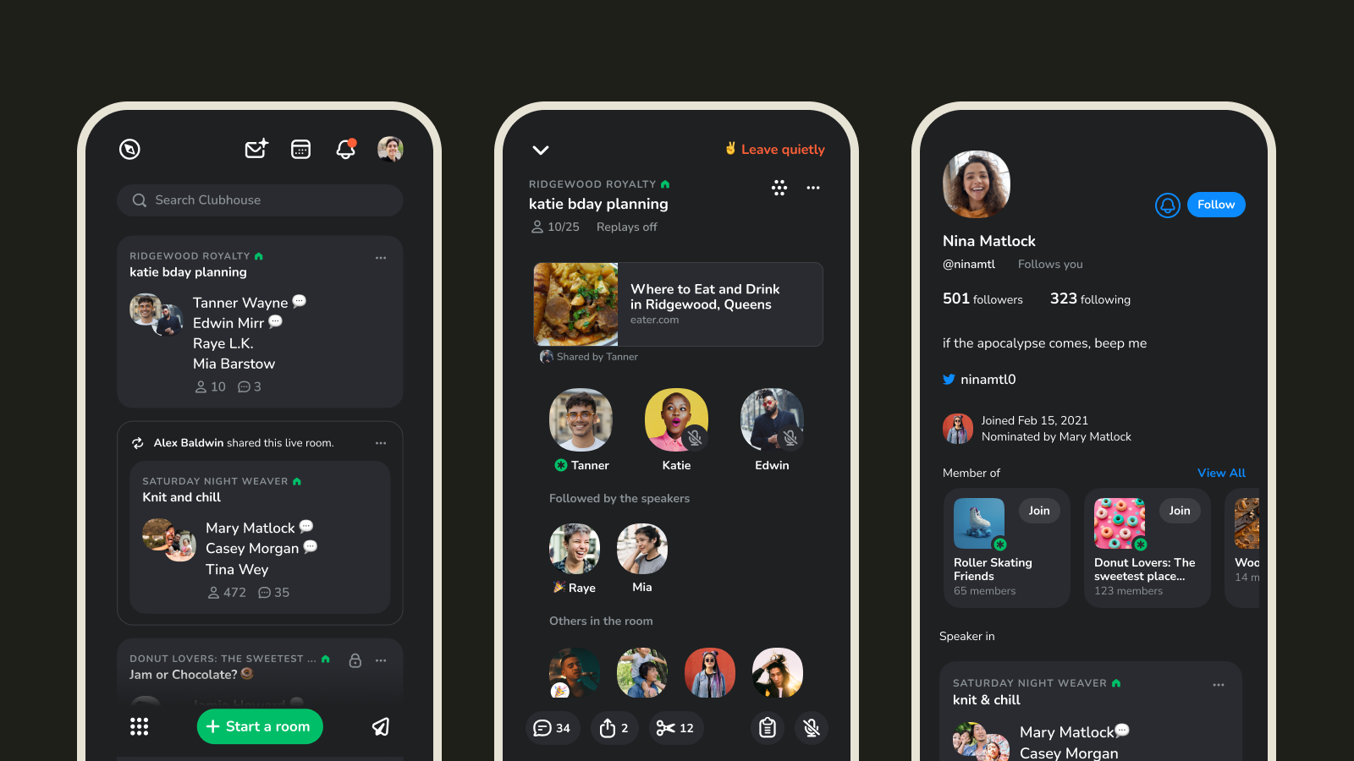
DARK MODE (2020)
easy on the eyes and make colors and design elements pop
also in mobile (2022)

Slide 3
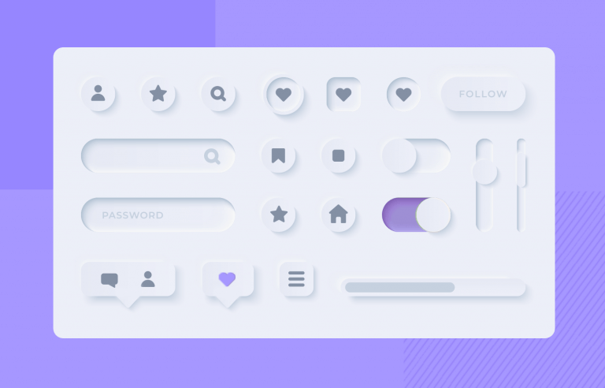
NEUMORPHISM (2021)
minimal way to design with a soft look, imitating physicality by overlaying drop shadows
semi-flat design that looks more realistic
also in mobile (2022)

Slide 4

SCROLLING TRANSFORMATIONS (2022)
evolution of Horizontal Scrolling, Scroll Animations, and Scrollytelling
websites are more interactive and accessible

Slide 5
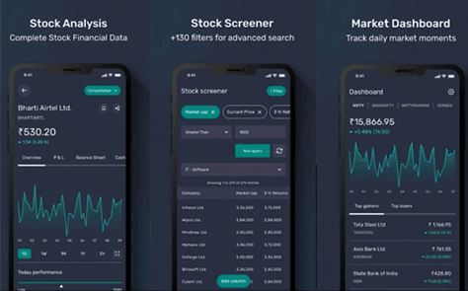
SDATA VISUALIZATIONS (2022)
more quick and effective
data visualizations are an important part of any app with a lot of complex information (people can process visuals 60 000 faster than text)
Notes:
On mobile

Slide 6

GOODBYE FLASH
started to disappear around the mid-2000s
user frustrations (constant updating)
Google blocked Flash content content in 2016
Notes:
outdated

Slide 7
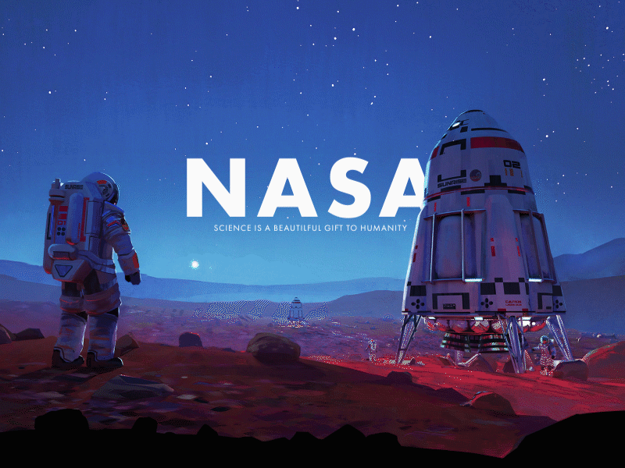
PARALLAX ANIMATION
parallax refers to the faster movement of foreground objects than background ones when users scroll up and down
this technique produces an optical illusion about the distance of 2D or 3D scenes
Notes:
my favorite - would like to try

Slide 8
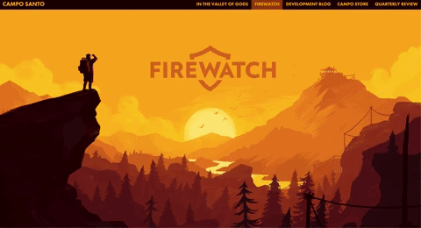
FIREWATCH
(2016)
Notes:
cool videogame that has that trend on their website

Slide 9
USED MATERIALS
https://www.designveloper.com/blog/web-design-trends/
https://99designs.com/blog/trends/web-design-trends-2020/#1
https://www.uxmatters.com/mt/archives/2022/05/top-8-mobile-app-design-trends-for-2022.php
https://www.digitalnext.com.au/outdated-website-design/

